Slide 1
Sequences and
Series
Twitter: @Owen134866
www.mathsfreeresourcelibrary.com

Slide 2



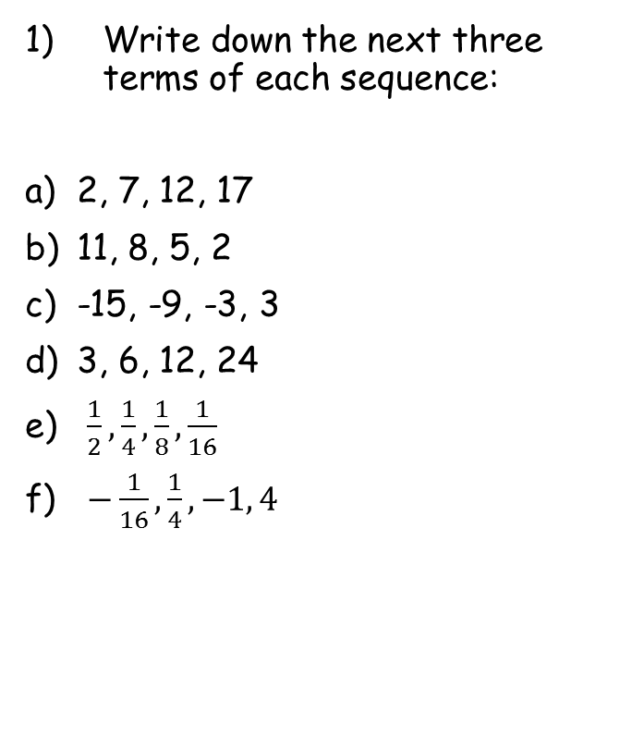




Prior Knowledge Check
Write down the next three terms of each sequence:
2, 7, 12, 17
11, 8, 5, 2
-15, -9, -3, 3
3, 6, 12, 24
$\frac{1}{2}, \frac{1}{4}, \frac{1}{8}, \frac{1}{16}$
$−\frac{1}{16}, \frac{1}{4}, −1, 4$
2) Solve, giving your answers to 3sf:
a) $2^{x}=50$
b) ${0.2}^{x}=0.0035$
c) $4×3^{x}=78732$
5.64
$$22, 27, 32$$
3.51
$$−1, −4, −7$$
9.00
$$9, 15, 21$$
$$48, 96, 192$$
$$\frac{1}{32}, \frac{1}{64}, \frac{1}{128}$$
$$−16, 64, −256$$

Slide 3
Teachings for
Section 3A

Slide 4





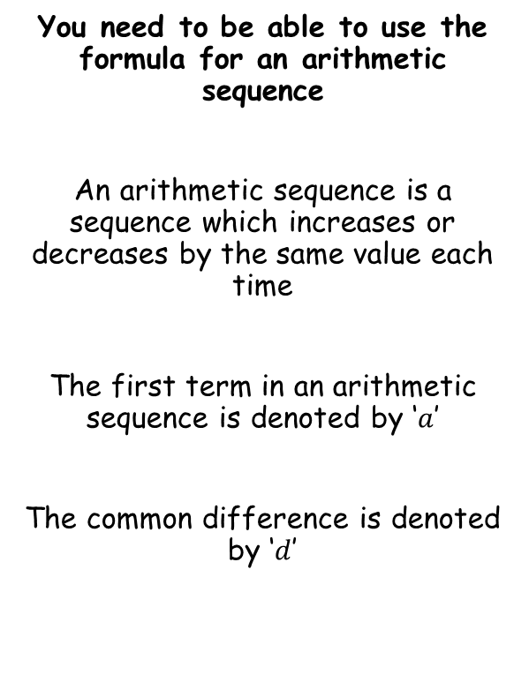






Sequences and Series
$$u_{n}=a+(n−1)d$$
You need to be able to use the formula for an arithmetic sequence
An arithmetic sequence is a sequence which increases or decreases by the same value each time
The first term in an arithmetic sequence is denoted by ‘$a$’
The common difference is denoted by ‘$d$’
$$1st$$
$$term$$
$$2nd$$
$$term$$
$$3rd$$
$$term$$
$$4th$$
$$term$$
$$nth$$
$$term$$
$$a$$
$$a+d$$
$$a+2d$$
$$a+3d$$
$$a+(n−1)d$$
You need to be able to use the formula above in problem solving
3A

Slide 5









Sequences and Series
$$u_{n}=a+(n−1)d$$
You need to be able to use the formula for an arithmetic sequence
An arithmetic sequence is generated as follows:
6, 20, 34, 48, 72…
Find the nth term
Find the first term in the sequence that exceeds 200
$$u_{n}=a+(n−1)d$$
Sub in $a$ and $d$
$$u_{n}=(6)+(n−1)(14)$$
Expand bracket
$$u_{n}=6+14n−14$$
Simplify
$$u_{n}=14n−8$$
$$u_{n}=14n−8$$
→ A good starting point is to summarise $a$ and $d$
$$a=6$$
$$d=14$$
3A

Slide 6



Sequences and Series
$$u_{n}=a+(n−1)d$$
You need to be able to use the formula for an arithmetic sequence
An arithmetic sequence is generated as follows:
6, 20, 34, 48, 72…
Find the nth term
Find the first term in the sequence that exceeds 200
$$14n−8>200$$
Add 8
$$14n>208$$
Divide by 14
$$n>14.857…$$
Since n has to be an integer, the first term to exceed 200 will be the 15th one!
$$u_{n}=14n−8$$
→ We want to know when the sequence first generates a term above 200…
3A

Slide 7






Sequences and Series
$$u_{n}=a+(n−1)d$$
You need to be able to use the formula for an arithmetic sequence
An arithmetic sequence is generated as follows:
101, 94, 87, 80, 73…
Find the nth term
Find the first term in the sequence that is negative
$$u_{n}=a+(n−1)d$$
Sub in $a$ and $d$
$$u_{n}=(101)+(n−1)(−7)$$
Expand bracket
$$u_{n}=101−7n+7$$
Simplify
$$u_{n}=108−7n$$
$$u_{n}=108−7n$$
→ A good starting point is to summarise $a$ and $d$
$$a=101$$
$$d=−7$$
3A

Slide 8



Sequences and Series
$$u_{n}=a+(n−1)d$$
You need to be able to use the formula for an arithmetic sequence
An arithmetic sequence is generated as follows:
101, 94, 87, 80, 73…
Find the nth term
Find the first term in the sequence that exceeds 200
$$108−7n<0$$
Subtract 108
$$−7n<−108$$
Divide by -7
(remember this flips the inequality sign)
$$n>15.42…$$
Since n has to be an integer, the first term to be negative will be the 16th one!
$$u_{n}=108−7n$$
→ We want to know when the sequence first generates a term below 0…
3A

Slide 9





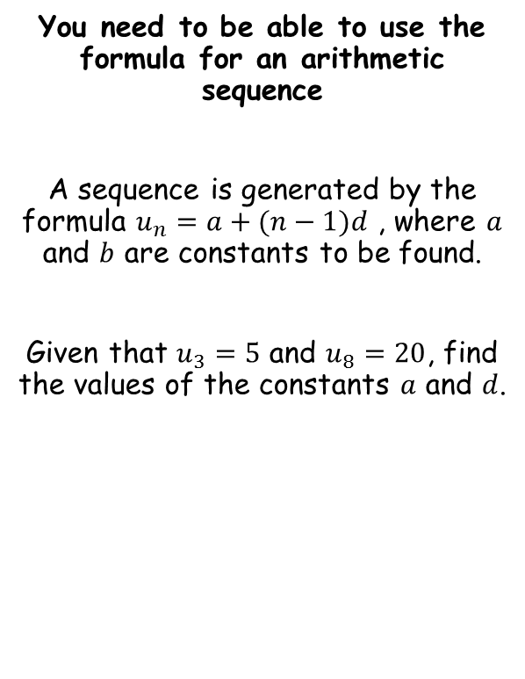









Sequences and Series
$$u_{n}=a+(n−1)d$$
You need to be able to use the formula for an arithmetic sequence
A sequence is generated by the formula $u_{n}=a+(n−1)d$ , where $a$ and $b$ are constants to be found.
Given that $u_{3}=5$ and $u_{8}=20$, find the values of the constants $a$ and $d$.
$$u_{n}=a+(n−1)d$$
When $n=3$, $u_{n}=5$
When $n=8$, $u_{n}=20$
$$5=a+(3−1)d$$
$$20=a+(8−1)d$$
1)
$$5=a+2d$$
2)
$$20=a+7d$$
Calculate 2) – 1)
$$15=5d$$
Divide by 3
$$3=d$$
Now find $a$
$$5=a+2d$$
Sub in $d=3$
$$5=a+2(3)$$
Calculate a
$$−1=a$$
3A

Slide 10
Teachings for
Section 3B

Slide 11
Sequences and Series
$$u_{n}=a+(n−1)d$$
You need to be able to solve problems involving an arithmetic series, which is the sum of a set of numbers in an arithmetic sequence
5, 7, 9, 11 → Arithmetic sequence
5+7+9+11 → Arithmetic series
3B

Slide 12
Sequences and Series
$$u_{n}=a+(n−1)d$$
The Sum of an Arithmetic Series
You need to be able to work out the sum of numbers in an arithmetic sequence.
Add up the numbers from 1-100!
This method was discovered by Carl Friedrich Gauss (1777-1855) while he was still in Primary School!
Write out the same sequence backwards
Add both sequences together
We have 100 lots of 101
Halve that to get the actual total
3B

Slide 13
Sequences and Series
$$u_{n}=a+(n−1)d$$
You might be asked to prove this on your exam!
The Sum of an Arithmetic Series
As a general rule:
…, …, …
…, …, …
Group the a’s
Multiply out the bracket
…, …, …
Group the d’s
Factorise the 2nd part
There are ‘n lots of 2a + (n-1)d’
Divide by 2
If L is the last term in the series
3B

Slide 14



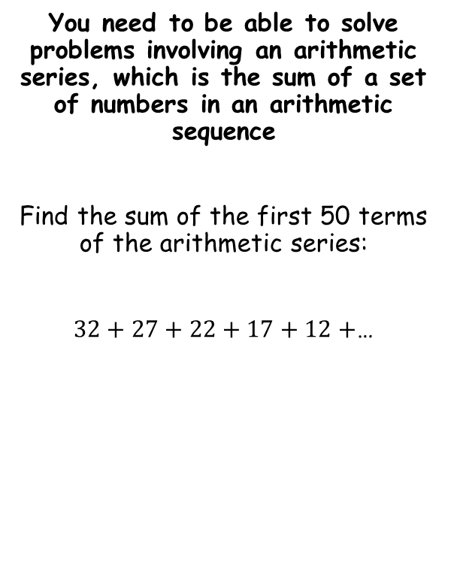





Sequences and Series
$$u_{n}=a+(n−1)d$$
$$S_{n}=\frac{n}{2}\left(2a+\left(n−1\right)d\right)$$
$$S_{n}=\frac{n}{2}\left(a+l\right)$$
You need to be able to solve problems involving an arithmetic series, which is the sum of a set of numbers in an arithmetic sequence
Find the sum of the first 50 terms of the arithmetic series:
$32+27+22+17+12+$…
$$S_{n}=\frac{n}{2}\left(2a+\left(n−1\right)d\right)$$
Sub in values
$$S_{n}=\frac{(50)}{2}\left(2(32)+\left(50−1\right)(−5)\right)$$
Calculate
$$S_{n}=−4525$$
$$a=32$$
$$d=−5$$
$$n=50$$
3B

Slide 15











Sequences and Series
$$u_{n}=a+(n−1)d$$
$$S_{n}=\frac{n}{2}\left(2a+\left(n−1\right)d\right)$$
$$S_{n}=\frac{n}{2}\left(a+l\right)$$
You need to be able to solve problems involving an arithmetic series, which is the sum of a set of numbers in an arithmetic sequence
Find the smallest number of terms required for the sum of $4+9+14+19+$… to exceed 2000.
Find the number of terms required for the sequence to sum to exactly 2000
$$S_{n}=\frac{n}{2}\left(2a+\left(n−1\right)d\right)$$
Sub in values
$$2000=\frac{n}{2}\left(2(4)+\left(n−1\right)(5)\right)$$
Multiply both sides by 2
$$4000=n\left(2(4)+\left(n−1\right)(5)\right)$$
Simplify the inner part of the large bracket
$$a=4$$
$$4000=n\left(3+5n\right)$$
Expand bracket
$$d=5$$
$$4000=3n+{5n}^{2}$$
$$n=?$$
Subtract 4000
$$S_{n}>2000$$
$$0={5n}^{2}+3n−4000$$
At this point we can try factorising, although the quadratic formula will probably be easier!
3B

Slide 16








Sequences and Series
$$u_{n}=a+(n−1)d$$
$$S_{n}=\frac{n}{2}\left(2a+\left(n−1\right)d\right)$$
$$S_{n}=\frac{n}{2}\left(a+l\right)$$
You need to be able to solve problems involving an arithmetic series, which is the sum of a set of numbers in an arithmetic sequence
Find the smallest number of terms required for the sum of $4+9+14+19+$… to exceed 2000.
$$0={5n}^{2}+3n−4000$$
$$a=5$$
$$b=3$$
$$c=−4000$$
$$n=\frac{−b±\sqrt{b^{2}−4ac}}{2a}$$
Sub in values
$$n=\frac{−(3)±\sqrt{{(3)}^{2}−4(5)(−4000)}}{2(5)}$$
Calculate
$$n=27.99 or −28.59$$
Since $n$ has to be a positive integer, the first value that will cause the sum of the sequence to be greater than 2000 will be the 28th term.
3B

Slide 17
Teachings for
Section 3C

Slide 18

Sequences and Series
$$u_{n}=ar^{n−1}$$
Geometric sequences are formed by multiplying a starting value by a common ratio
a, ar, ar², ar³, …, ar^{n-1}
Example Questions
Find the nth and 10th terms of the following sequences…
a)
3, 6, 12, 24…
First Term
= 3
1st Term
2nd Term
3rd Term
4th Term
n^{th} Term
Common Ratio
= 2
Nth Term
= 3 x 2^{n-1}
10th Term
= 3 x 2⁹
= 1536
3C

Slide 19
Sequences and Series
$$u_{n}=ar^{n−1}$$
Geometric sequences are formed by multiplying a starting value by a common ratio
a, ar, ar², ar³, …, ar^{n-1}
Example Questions
Find the nth and 10th terms of the following sequences…
b)
40, -20, 10, -5…
First Term
= 40
1st Term
2nd Term
3rd Term
4th Term
n^{th} Term
Common Ratio
= -0.5
Nth Term
= 40 x (-0.5)^{n-1}
10th Term
= 40 x (-0.5)⁹
= -⁵/₆₄
3C

Slide 20
Sequences and Series
$$u_{n}=ar^{n−1}$$
Geometric sequences are formed by multiplying a starting value by a common ratio
a, ar, ar², ar³, …, ar^{n-1}
Example Questions
The second term of a Geometric sequence is 4, and the 4th term is 8. Find the values of the common ratio and the first term
1
2nd Term →
1st Term
2nd Term
3rd Term
4th Term
n^{th} Term
2
4th Term →
2 ÷ 1 →
Square root
Sub r into 1
Divide by √2
Rationalise
3C

Slide 21
Sequences and Series
$$u_{n}=ar^{n−1}$$
Geometric sequences are formed by multiplying a starting value by a common ratio
a, ar, ar², ar³, …, ar^{n-1}
Example Questions
The numbers 3, x, and (x + 6) form the first three terms of a positive geometric sequence. Calculate the 15th term of the sequence
1st Term
2nd Term
3rd Term
4th Term
n^{th} Term
Cross Multiply by 3 and x
Set equal to 0
Factorise
x has to be positive
3C

Slide 22
Sequences and Series
$$u_{n}=ar^{n−1}$$
Geometric sequences are formed by multiplying a starting value by a common ratio
a, ar, ar², ar³, …, ar^{n-1}
Example Questions
The numbers 3, x, and (x + 6) form the first three terms of a positive geometric sequence. Calculate the 15th term of the sequence
1st Term
2nd Term
3rd Term
4th Term
n^{th} Term
First term = 3
Common Ratio = 2
Nth term = 3 x 2^{n-1}
15th Term = 3 x 2¹⁴
15th Term = 49,152
3C

Slide 23
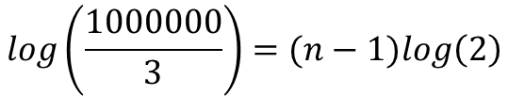

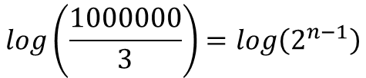

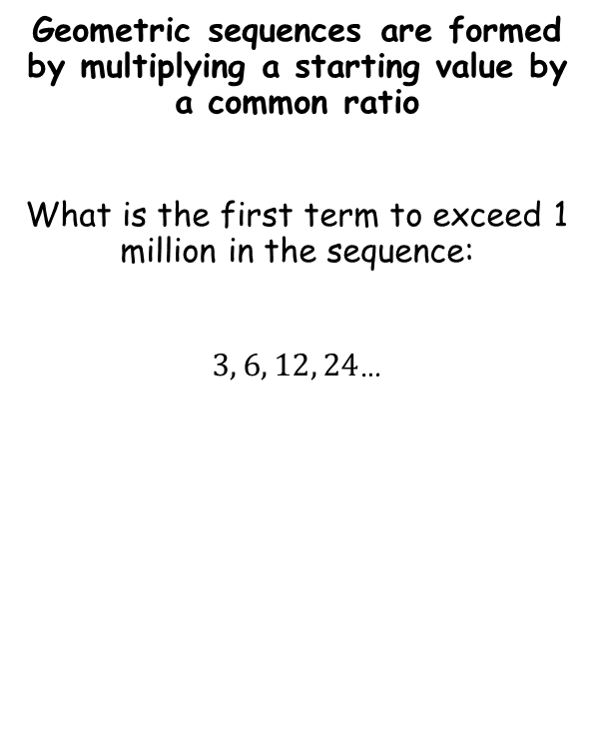



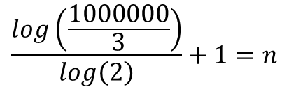

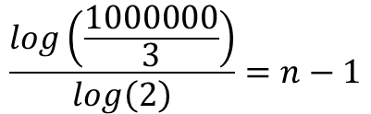
Sequences and Series
$$u_{n}=ar^{n−1}$$
$$u_{n}=ar^{n−1}$$
Geometric sequences are formed by multiplying a starting value by a common ratio
What is the first term to exceed 1 million in the sequence:
$3, 6, 12, 24$…
Sub in values
$$1000000=3×2^{n−1}$$
Divide by 3
$$\frac{1000000}{3}=2^{n−1}$$
Take logs of both sides
$$log\left(\frac{1000000}{3}\right)=log\left(2^{n−1}\right)$$
Use the power law
$$log\left(\frac{1000000}{3}\right)=(n−1)log\left(2\right)$$
$$a=3$$
$$r=2$$
Divide by log 2
$$u_{n}>1000000$$
$$\frac{log\left(\frac{1000000}{3}\right)}{log\left(2\right)}=n−1$$
Add 1
$$\frac{log\left(\frac{1000000}{3}\right)}{log\left(2\right)}+1=n$$
3C

Slide 24

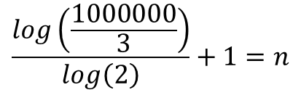
Sequences and Series
$$u_{n}=ar^{n−1}$$
Geometric sequences are formed by multiplying a starting value by a common ratio
What is the first term to exceed 1 million in the sequence:
$3, 6, 12, 24$…
$$\frac{log\left(\frac{1000000}{3}\right)}{log\left(2\right)}+1=n$$
Calculate
$$19.35=n$$
So the first term to exceed 1 million will be the 20th term!
$$a=3$$
$$r=2$$
$$u_{n}>1000000$$
3C

Slide 25
Teachings for
Section 3D

Slide 26


Sequences and Series
$$u_{n}=ar^{n−1}$$
$$S_{n}=\frac{a\left(1−r^{n}\right)}{(1−r)}$$
You need to be able to work out the sum of a Geometric Series
1
Multiply all terms by r
2
1 - 2
Factorise both sides
You might be asked to prove this on your exam!
Divide by (1 - r)
3D

Slide 27







Sequences and Series
$$u_{n}=ar^{n−1}$$
$$S_{n}=\frac{a\left(1−r^{n}\right)}{(1−r)}$$
You need to be able to work out the sum of a Geometric Series
Find the sum of the following Geometric Series:
$2+6+18+54$… (for 10 terms)
$$S_{n}=\frac{a\left(1−r^{n}\right)}{(1−r)}$$
Sub in values
$$S_{n}=\frac{(3)\left(1−{(3)}^{10}\right)}{(1−(3))}$$
Calculate
$$S_{n}=59048$$
$$a=2$$
$$r=3$$
$$n=10$$
3D

Slide 28


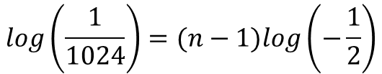

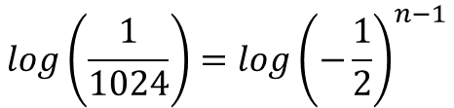

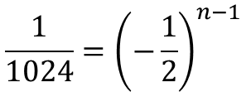

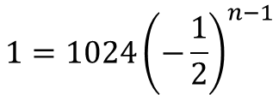
Sequences and Series
$$u_{n}=ar^{n−1}$$
$$S_{n}=\frac{a\left(1−r^{n}\right)}{(1−r)}$$
You need to be able to work out the sum of a Geometric Series
Find the sum of the following Geometric Series:
$1024−512+256−128+$……$+1$
$$u_{n}=ar^{n−1}$$
Sub in values
$$1=1024{\left(−\frac{1}{2}\right)}^{n−1}$$
Divide by 1024
$$\frac{1}{1024}={\left(−\frac{1}{2}\right)}^{n−1}$$
Take logs of both sides
$$log\left(\frac{1}{1024}\right)={log\left(−\frac{1}{2}\right)}^{n−1}$$
$$a=1024$$
Use the power law
$$r=−\frac{1}{2}$$
$$log\left(\frac{1}{1024}\right)=(n−1)log\left(−\frac{1}{2}\right)$$
$$n= ?$$
Since we do not know how many terms there are, we will need to calculate this first
→ We can use the nth term formula to do this…
What is the problem here?
→ We cannot calculate the log of a negative value, so we need to find a way around this…
3D

Slide 29
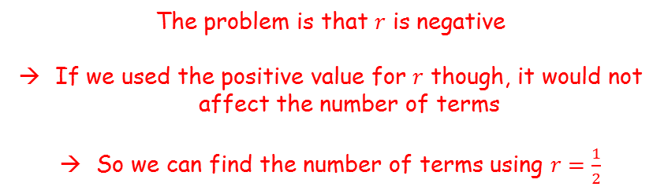






Sequences and Series
$$u_{n}=ar^{n−1}$$
$$S_{n}=\frac{a\left(1−r^{n}\right)}{(1−r)}$$
The problem is that $r$ is negative
If we used the positive value for $r$ though, it would not affect the number of terms
So we can find the number of terms using $r=\frac{1}{2}$
You need to be able to work out the sum of a Geometric Series
Find the sum of the following Geometric Series:
$1024−512+256−128+$……$+1$
$$u_{n}=ar^{n−1}$$
Sub in values, using $r=\frac{1}{2}$
$$1=1024{\left(\frac{1}{2}\right)}^{n−1}$$
$$a=1024$$
Divide by 1024
$$\frac{1}{1024}={\left(\frac{1}{2}\right)}^{n−1}$$
$$r=−\frac{1}{2}$$
Take logs of both sides
$$log\left(\frac{1}{1024}\right)={log\left(\frac{1}{2}\right)}^{n−1}$$
$$n= ?$$
Use the power law
$$log\left(\frac{1}{1024}\right)=(n−1)log\left(\frac{1}{2}\right)$$
3D

Slide 30





Sequences and Series
$$u_{n}=ar^{n−1}$$
$$S_{n}=\frac{a\left(1−r^{n}\right)}{(1−r)}$$
You need to be able to work out the sum of a Geometric Series
Find the sum of the following Geometric Series:
$1024−512+256−128+$……$+1$
$$log\left(\frac{1}{1024}\right)=(n−1)log\left(\frac{1}{2}\right)$$
Divide both by $log⁡\left(\frac{1}{2}\right)$
$$10=n−1$$
Add 1
$$11=n$$
$$a=1024$$
$$r=−\frac{1}{2}$$
$$n= ?$$
$$n=11$$
3D

Slide 31

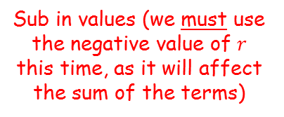

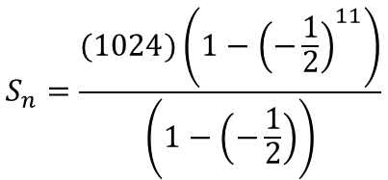
Sequences and Series
$$u_{n}=ar^{n−1}$$
$$S_{n}=\frac{a\left(1−r^{n}\right)}{(1−r)}$$
You need to be able to work out the sum of a Geometric Series
Find the sum of the following Geometric Series:
$1024−512+256−128+$……$+1$
$$S_{n}=\frac{a\left(1−r^{n}\right)}{(1−r)}$$
Sub in values (we must use the negative value of $r$ this time, as it will affect the sum of the terms)
$$S_{n}=\frac{(1024)\left(1−{\left(−\frac{1}{2}\right)}^{11}\right)}{\left(1−\left(−\frac{1}{2}\right)\right)}$$
Calculate
$$S_{n}=683$$
$$a=1024$$
$$r=−\frac{1}{2}$$
$$n=11$$
3D

Slide 32















Sequences and Series
$$u_{n}=ar^{n−1}$$
$$S_{n}=\frac{a\left(1−r^{n}\right)}{(1−r)}$$
$$S_{n}=\frac{a\left(1−r^{n}\right)}{(1−r)}$$
You need to be able to work out the sum of a Geometric Series
Find the least value of $n$ such that the sum of the following series exceeds 2,000,000:
$$1+2+4+8…$$
Sub in values
$$2000000=\frac{(1)\left(1−{(2)}^{n}\right)}{(1−2)}$$
Simplify right side
$$2000000=\frac{\left(1−{(2)}^{n}\right)}{−1}$$
Multiply by -1
$$−2000000=1−{(2)}^{n}$$
Add 2000000, Add $2^{n}$
$$a=1$$
$$2^{n}=2000001$$
Take logs of both sides
$$r=2$$
$$log\left(2^{n}\right)=log\left(2000001\right)$$
Use the power law
$$n= ?$$
$$nlog\left(2\right)=log\left(2000001\right)$$
Divide by $log\left(2\right)$
$$S_{n}>2000000$$
$$n=\frac{log\left(2000001\right)}{log\left(2\right)}$$
Calculate
So the smallest value of $n$ that will cause the sum of the sequence to exceed 2000000 is 21
$$n=20.9$$
3D

Slide 33
Teachings for
Section 3E

Slide 34
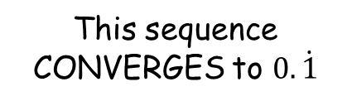

Sequences and Series
$$u_{n}=ar^{n−1}$$
$$S_{n}=\frac{a\left(1−r^{n}\right)}{(1−r)}$$
You need to be able to calculate the sum to infinity of a Geometric Series, and understand when this is possible
This sequence CONVERGES to $0.\dot{1}$
$$u_{n}=\frac{1}{{10}^{n}}$$
First 4 terms
As Decimals
A Sequence will converge if the common ratio, r is between -1 and 1.
Sum of 1st term
Sum of 1st and 2nd terms
Sum of 1st to 3rd terms
Sum of 1st to 4th terms
3E

Slide 35



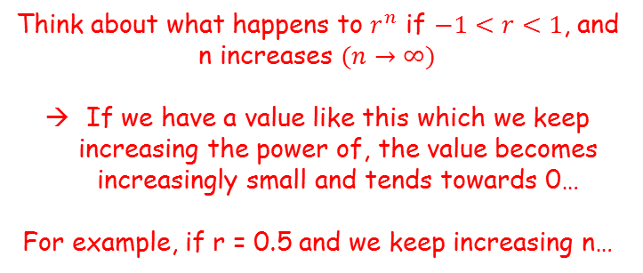

Sequences and Series
$$u_{n}=ar^{n−1}$$
$$S_{n}=\frac{a\left(1−r^{n}\right)}{(1−r)}$$
You need to be able to calculate the sum to infinity of a Geometric Series, and understand when this is possible
Think about what happens to $r^{n}$ if $−1<r<1$, and n increases $(n→∞)$
If we have a value like this which we keep increasing the power of, the value becomes increasingly small and tends towards 0…
For example, if r = 0.5 and we keep increasing n…
$$S_{n}=\frac{a\left(1−r^{n}\right)}{\left(1−r\right)}$$
For the conditions stated to the right, r^{n} will tend towards 0 as the sequence continues to infinity
0.5¹
→
0.5
$$S_{n}=\frac{a\left(1−0\right)}{\left(1−r\right)}$$
0.5²
→
0.25
Simplify
0.5³
→
0.125
$$S_{n}=\frac{a}{\left(1−r\right)}$$
0.5⁴
→
0.0625
0.5¹⁰
→
0.00097…
This formula calculates the sum to infinity of a sequence, if -1 < r < 1
So if $−1<r<1$, as $n→∞$, $r^{n}→0$
3E

Slide 36


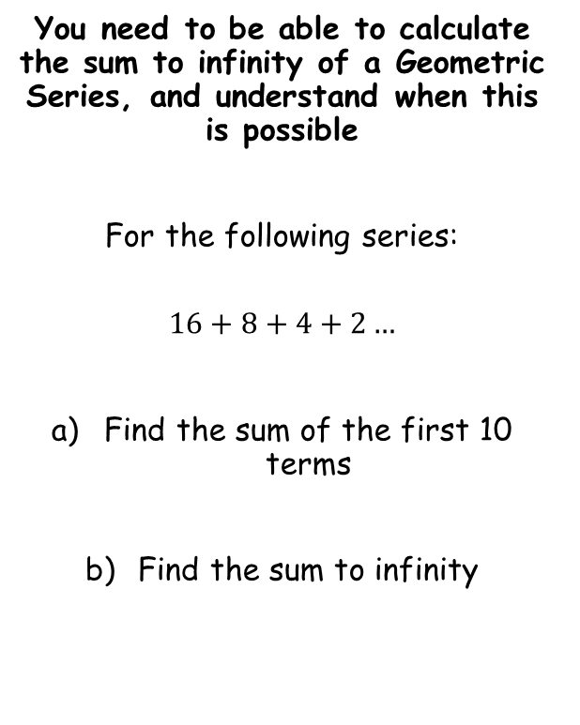





Sequences and Series
$$u_{n}=ar^{n−1}$$
$$S_{n}=\frac{a\left(1−r^{n}\right)}{(1−r)}$$
$$S_{∞}=\frac{a}{1−r}$$
You need to be able to calculate the sum to infinity of a Geometric Series, and understand when this is possible
For the following series:
$$16+8+4+2…$$
Find the sum of the first 10 terms
Find the sum to infinity
$$S_{n}=\frac{a\left(1−r^{n}\right)}{(1−r)}$$
Sub in values
$$S_{n}=\frac{16\left(1−{0.5}^{10}\right)}{(1−0.5)}$$
Calculate
$$S_{n}=31.96875$$
$$S_{∞}=\frac{a}{1−r}$$
Sub in values
$$S_{∞}=\frac{16}{1−0.5}$$
Calculate
$$S_{∞}=32$$
3E

Slide 37








Sequences and Series
$$u_{n}=ar^{n−1}$$
$$S_{n}=\frac{a\left(1−r^{n}\right)}{(1−r)}$$
$$S_{∞}=\frac{a}{1−r}$$
You need to be able to calculate the sum to infinity of a Geometric Series, and understand when this is possible
The fourth term of a geometric series is 1.08 and the seventh is 0.23328.
Show that the series is convergent
Calculate the sum to infinity of the series
$$u_{n}=ar^{n−1}$$
The fourth term is 1.08
The seventh term is 0.23328
1)
$$1.08=ar^{3}$$
2)
$$0.23328=ar^{6}$$
2) ÷ 1)
$$\frac{0.23328}{1.08}=\frac{ar^{6}}{ar^{3}}$$
Calculate
$$0.216=r^{3}$$
Cube root
$$r=0.6$$
$$0.6=r$$
Since $−1<r<1$, the series is convergent
3E

Slide 38






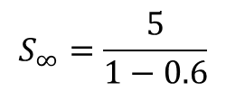


Sequences and Series
$$u_{n}=ar^{n−1}$$
$$S_{n}=\frac{a\left(1−r^{n}\right)}{(1−r)}$$
$$S_{∞}=\frac{a}{1−r}$$
You need to be able to calculate the sum to infinity of a Geometric Series, and understand when this is possible
The fourth term of a geometric series is 1.08 and the seventh is 0.23328.
Show that the series is convergent
Calculate the sum to infinity of the series
We need to calculate $a$, and can use an equation from the previous part
$$1.08=ar^{3}$$
Sub in $r$
$$1.08=a{(0.6)}^{3}$$
Divide by ${(0.6)}^{3}$
$$5=a$$
$$S_{∞}=\frac{a}{1−r}$$
Sub in values
$$S_{∞}=\frac{5}{1−0.6}$$
Calculate
$$r=0.6$$
$$S_{∞}=12.5$$
3E

Slide 39


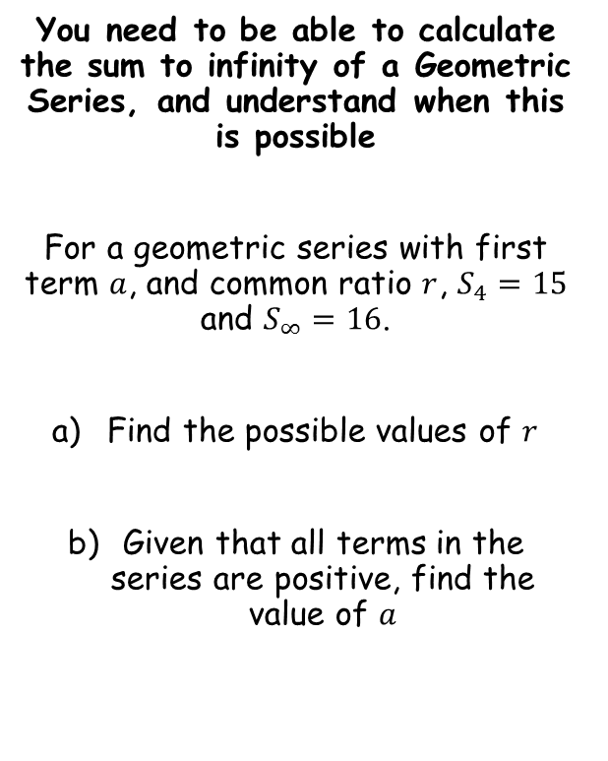


Sequences and Series
$$u_{n}=ar^{n−1}$$
$$S_{n}=\frac{a\left(1−r^{n}\right)}{(1−r)}$$
$$S_{∞}=\frac{a}{1−r}$$
You need to be able to calculate the sum to infinity of a Geometric Series, and understand when this is possible
For a geometric series with first term $a$, and common ratio $r$, $S_{4}=15$ and $S_{∞}=16$.
Find the possible values of $r$
Given that all terms in the series are positive, find the value of $a$
$$S_{n}=\frac{a\left(1−r^{n}\right)}{(1−r)}$$
Sub in values – the sum of the first 4 terms is 15
$$15=\frac{a\left(1−r^{4}\right)}{(1−r)}$$
$$S_{∞}=\frac{a}{1−r}$$
Sub in values – the sum to infinity is 16
$$16=\frac{a}{1−r}$$
3E

Slide 40

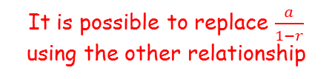







Sequences and Series
$$u_{n}=ar^{n−1}$$
$$S_{n}=\frac{a\left(1−r^{n}\right)}{(1−r)}$$
$$S_{∞}=\frac{a}{1−r}$$
You need to be able to calculate the sum to infinity of a Geometric Series, and understand when this is possible
For a geometric series with first term $a$, and common ratio $r$, $S_{4}=15$ and $S_{∞}=16$.
Find the possible values of $r$
Given that all terms in the series are positive, find the value of $a$
$$15=\frac{a\left(1−r^{4}\right)}{(1−r)}$$
It is possible to replace $\frac{a}{1−r}$ using the other relationship
$$15=16\left(1−r^{4}\right)$$
Divide by 16
$$\frac{15}{16}=1−r^{4}$$
Add $r^{4}$, subtract $\frac{15}{16}$
$$r^{4}=\frac{1}{16}$$
Take the fourth root
$$r=±\frac{1}{2}$$
$$15=\frac{a\left(1−r^{4}\right)}{(1−r)}$$
$$16=\frac{a}{1−r}$$
3E

Slide 41




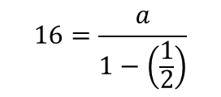

Sequences and Series
$$u_{n}=ar^{n−1}$$
$$S_{n}=\frac{a\left(1−r^{n}\right)}{(1−r)}$$
$$S_{∞}=\frac{a}{1−r}$$
You need to be able to calculate the sum to infinity of a Geometric Series, and understand when this is possible
For a geometric series with first term $a$, and common ratio $r$, $S_{4}=15$ and $S_{∞}=16$.
Find the possible values of $r$
Given that all terms in the series are positive, find the value of $a$
$$16=\frac{a}{1−r}$$
Sub in the positive value of $r$
$$16=\frac{a}{1−\left(\frac{1}{2}\right)}$$
Calculate denominator
$$16=\frac{a}{0.5}$$
Multiply by 0.5
$$8=a$$
$$r=±\frac{1}{2}$$
$$15=\frac{a\left(1−r^{4}\right)}{(1−r)}$$
$$16=\frac{a}{1−r}$$
3E

Slide 42
Teachings for
Section 3F

Slide 43
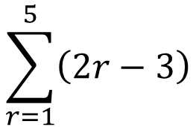








Sequences and Series
$$u_{n}=ar^{n−1}$$
$$S_{∞}=\frac{a}{1−r}$$
$$S_{n}=\frac{n}{2}\left(2a+\left(n−1\right)d\right)$$
$$u_{n}=a+(n−1)d$$
$$S_{n}=\frac{a\left(1−r^{n}\right)}{(1−r)}$$
$$S_{n}=\frac{n}{2}\left(a+l\right)$$
You need to be able to understand series questions where the Greek Sigma notation is used (for both arithmetic and Geometric series)
This is the value of $r$ we use to find the last term
The Greek letter ‘capital sigma’ means ‘sum of’
$$\sum_{r=1}^{5}{\left(2r−3\right)}$$
$$=−1+1+3+5+7$$
This is the value of $r$ we use to find the first term
This is the nth term formula for the series we are summing
3F

Slide 44
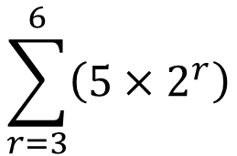


Sequences and Series
$$u_{n}=ar^{n−1}$$
$$S_{∞}=\frac{a}{1−r}$$
$$S_{n}=\frac{n}{2}\left(2a+\left(n−1\right)d\right)$$
$$u_{n}=a+(n−1)d$$
$$S_{n}=\frac{a\left(1−r^{n}\right)}{(1−r)}$$
$$S_{n}=\frac{n}{2}\left(a+l\right)$$
You need to be able to understand series questions where the Greek Sigma notation is used (for both arithmetic and Geometric series)
This is the value of $r$ we use to find the last term
The Greek letter ‘capital sigma’ means ‘sum of’
$$\sum_{r=3}^{6}{\left(5×2^{r}\right)}$$
$$=40+80+160+320$$
This is the value of $r$ we use to find the first term
→ It does not have to be 1!
This is the nth term formula for the series we are summing
3F

Slide 45


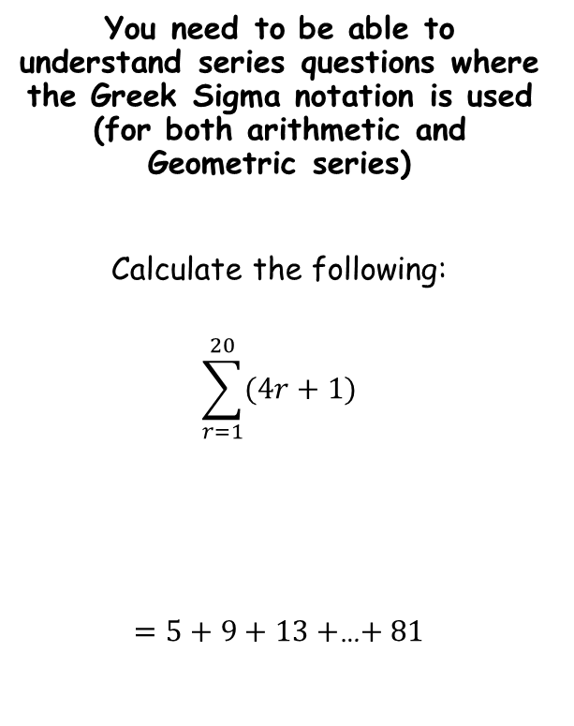




Sequences and Series
$$u_{n}=ar^{n−1}$$
$$S_{∞}=\frac{a}{1−r}$$
$$S_{n}=\frac{n}{2}\left(2a+\left(n−1\right)d\right)$$
$$u_{n}=a+(n−1)d$$
$$S_{n}=\frac{a\left(1−r^{n}\right)}{(1−r)}$$
$$S_{n}=\frac{n}{2}\left(a+l\right)$$
Remember to consider whether the sequence is arithmetic or geometric…
You need to be able to understand series questions where the Greek Sigma notation is used (for both arithmetic and Geometric series)
Calculate the following:
$$\sum_{r=1}^{20}{(4r+1)}$$
$=5+9+13+$…$+ 81$
$$S_{n}=\frac{n}{2}\left(2a+\left(n−1\right)d\right)$$
Sub in values
$$S_{n}=\frac{20}{2}\left(2(5)+\left(20−1\right)(4)\right)$$
Calculate
$$S_{n}=860$$
It can help to write a few terms of the sequence out first…
$$a=5$$
$$d=4$$
$$n=20$$
3F

Slide 46


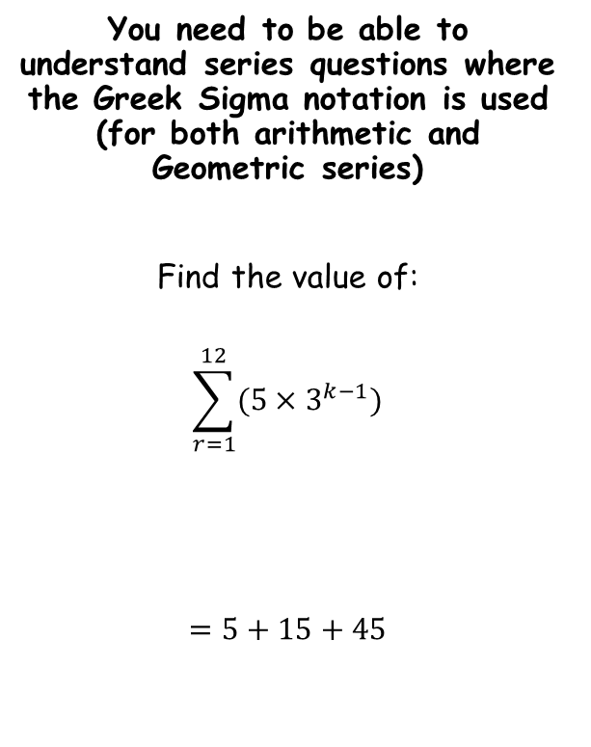



Sequences and Series
$$u_{n}=ar^{n−1}$$
$$S_{∞}=\frac{a}{1−r}$$
$$S_{n}=\frac{n}{2}\left(2a+\left(n−1\right)d\right)$$
$$u_{n}=a+(n−1)d$$
$$S_{n}=\frac{a\left(1−r^{n}\right)}{(1−r)}$$
$$S_{n}=\frac{n}{2}\left(a+l\right)$$
You need to be able to understand series questions where the Greek Sigma notation is used (for both arithmetic and Geometric series)
Find the value of:
$$\sum_{r=1}^{12}{(5×3^{k−1})}$$
$$=5+15+45$$
$$S_{n}=\frac{a\left(1−r^{n}\right)}{(1−r)}$$
Sub in values
$$S_{n}=\frac{5\left(1−3^{12}\right)}{(1−3)}$$
Calculate
$$S_{n}=1328600$$
It can help to write a few terms of the sequence out first…
$$a=5$$
$$r=3$$
$$n=12$$
3F

Slide 47


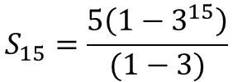

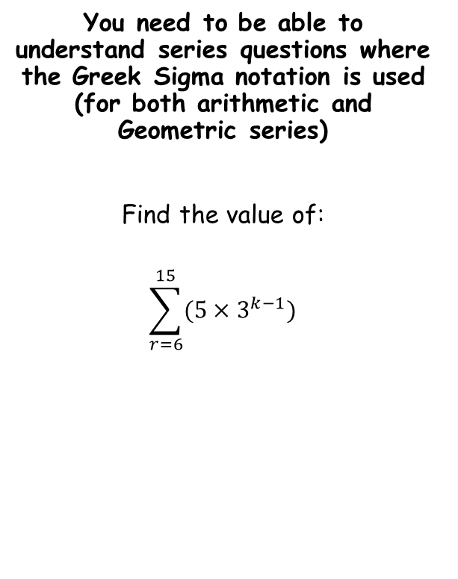


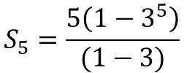
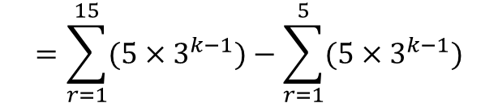
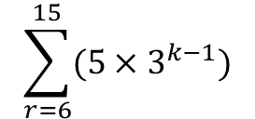

Sequences and Series
$$u_{n}=ar^{n−1}$$
$$S_{∞}=\frac{a}{1−r}$$
$$S_{n}=\frac{n}{2}\left(2a+\left(n−1\right)d\right)$$
$$u_{n}=a+(n−1)d$$
$$S_{n}=\frac{a\left(1−r^{n}\right)}{(1−r)}$$
$$S_{n}=\frac{n}{2}\left(a+l\right)$$
$$\sum_{r=6}^{15}{(5×3^{k−1})}$$
You need to be able to understand series questions where the Greek Sigma notation is used (for both arithmetic and Geometric series)
Find the value of:
$$\sum_{r=6}^{15}{(5×3^{k−1})}$$
Write as a subtraction
$$=\sum_{r=1}^{15}{(5×3^{k−1})}−\sum_{r=1}^{5}{(5×3^{k−1})}$$
$$S_{n}=\frac{a\left(1−r^{n}\right)}{(1−r)}$$
$$S_{n}=\frac{a\left(1−r^{n}\right)}{(1−r)}$$
$$S_{15}=\frac{5\left(1−3^{15}\right)}{(1−3)}$$
$$S_{5}=\frac{5\left(1−3^{5}\right)}{(1−3)}$$
The sum of the 6th to the 15th terms will be equal to:
The sum of the first 15 terms
subtract
The sum of the first 5 terms
$$S_{15}=35872265$$
$$S_{5}=605$$
Now we can subtract…
$$=35872265−605$$
$$=35871660$$
3F

Slide 48
Teachings for
Section 3G

Slide 49
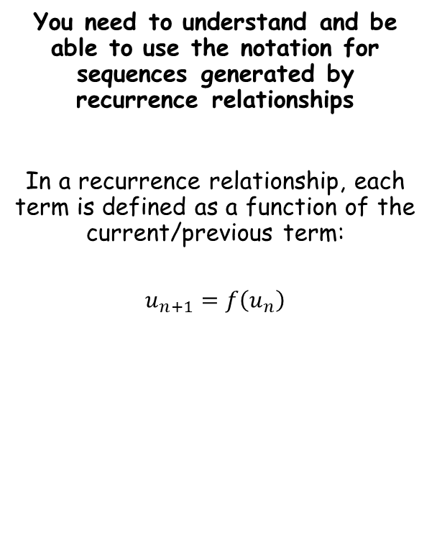
Sequences and Series
You need to understand and be able to use the notation for sequences generated by recurrence relationships
In a recurrence relationship, each term is defined as a function of the current/previous term:
$$u_{n+1}=f\left(u_{n}\right)$$
The next term…
…is a function of the previous term
3G

Slide 50




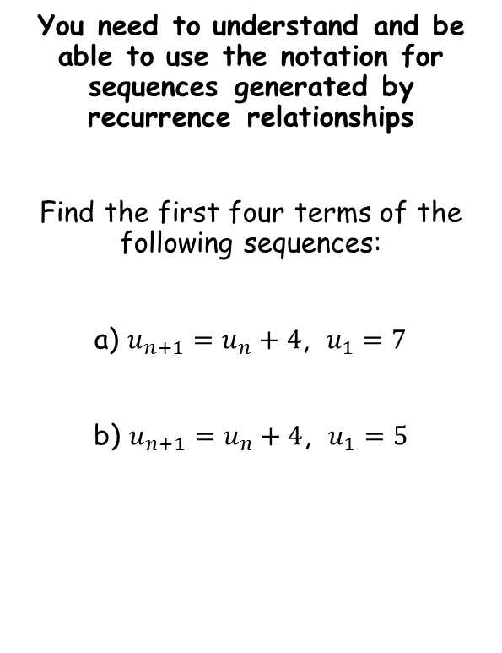






Sequences and Series
You need to understand and be able to use the notation for sequences generated by recurrence relationships
Find the first four terms of the following sequences:
a) $u_{n+1}=u_{n}+4$, $u_{1}=7$
b) $u_{n+1}=u_{n}+4$, $u_{1}=5$
$$u_{n+1}=u_{n}+4\text{, }{ u}_{1}=7$$
‘To get the next term, add 4 to the current term.’ ‘The first term is 7’
$$7$$
$$11$$
$$15$$
$$19$$
$$u_{n+1}=u_{n}+4\text{, }{ u}_{1}=5$$
‘To get the next term, add 4 to the current term.’ ‘The first term is 5’
$$5$$
$$9$$
$$13$$
$$17$$
With recurrence relationships you need to know the relationship as well as a starting value!
3G

Slide 51



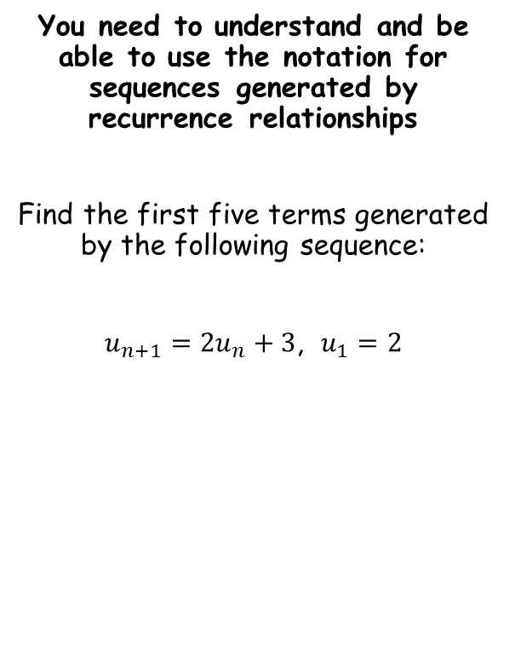



Sequences and Series
You need to understand and be able to use the notation for sequences generated by recurrence relationships
Find the first five terms generated by the following sequence:
$u_{n+1}=2u_{n}+3$, $u_{1}=2$
$$u_{n+1}=2u_{n}+3\text{, }u_{1}=2$$
‘To get the next term, multiply the current term by 2, and then add 3. The first term is 2’
$$2$$
$$7$$
$$17$$
$$37$$
$$77$$
3G

Slide 52




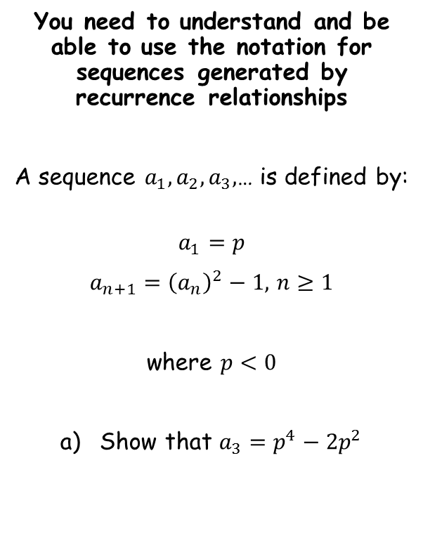






Sequences and Series
You need to understand and be able to use the notation for sequences generated by recurrence relationships
A sequence $a_{1}, a_{2}, a_{3},$… is defined by:
$$a_{1}=p$$
$a_{n+1}={\left(a_{n}\right)}^{2}−1,$ $n≥1$
where $p<0$
Show that $a_{3}=p^{4}−2p^{2}$
$$a_{1}=p$$
Use the relationship to find the second term
$$a_{2}={\left(a_{1}\right)}^{2}−1$$
Sub in $a_{1}$
$$a_{2}={\left(p\right)}^{2}−1$$
Simplify
$$a_{2}=p^{2}−1$$
Use the relationship to find the third term
$$a_{3}={\left(a_{2}\right)}^{2}−1$$
Sub in $a_{2}$
$$a_{3}={\left(p^{2}−1 \right)}^{2}−1$$
Expand bracket
$$a_{3}=p^{4}−2p^{2}+1−1$$
Simplify
$$a_{3}=p^{4}−2p^{2}$$
3G

Slide 53



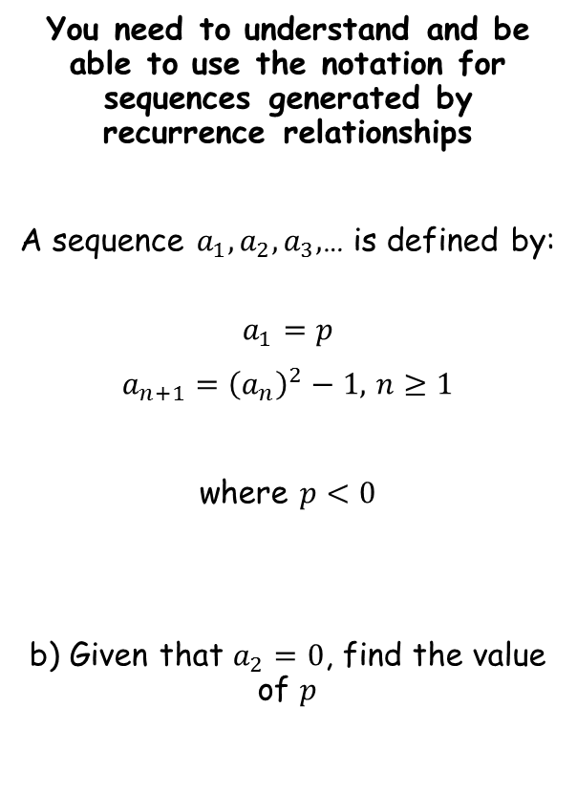




Sequences and Series
You need to understand and be able to use the notation for sequences generated by recurrence relationships
A sequence $a_{1}, a_{2}, a_{3},$… is defined by:
$$a_{1}=p$$
$a_{n+1}={\left(a_{n}\right)}^{2}−1,$ $n≥1$
where $p<0$
b) Given that $a_{2}=0$, find the value of $p$
$$a_{2}=p^{2}−1$$
Sub in $a_{2}=0$
$$0=p^{2}−1$$
Factorise
$$0=(p+1)(p−1)$$
Calculate answer
$p<0$ so therefore $p=−1$
$$a_{2}=p^{2}−1$$
$$a_{3}=p^{4}−2p^{2}$$
3G

Slide 54


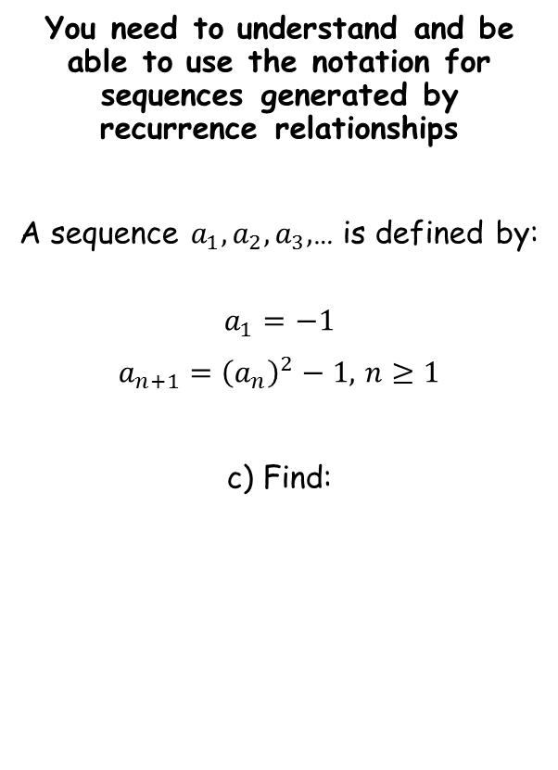



Sequences and Series
You need to understand and be able to use the notation for sequences generated by recurrence relationships
A sequence $a_{1}, a_{2}, a_{3},$… is defined by:
$$a_{1}=−1$$
$a_{n+1}={\left(a_{n}\right)}^{2}−1,$ $n≥1$
c) Find:
You are being asked to find the sum of the first 200 terms of this sequence
→ Remember that at this point we do not know whether it is arithmetic or geometric (or neither), so we should generate the first few terms and see what happens…
$$a_{1}=−1$$
Square and then subtract 1
$$a_{2}=0$$
Square and then subtract 1
$$a_{3}=−1$$
Square and then subtract 1
$$a_{4}=0$$
$$\sum_{r=1}^{200}{a_{r}}$$
This is not geometric or arithmetic, so we cannot use their formulae
However, every pair of term sum to -1
For 200 terms, there will be 100 pairs, so the sum will be -100
3G

Slide 55

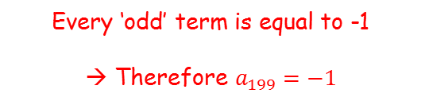
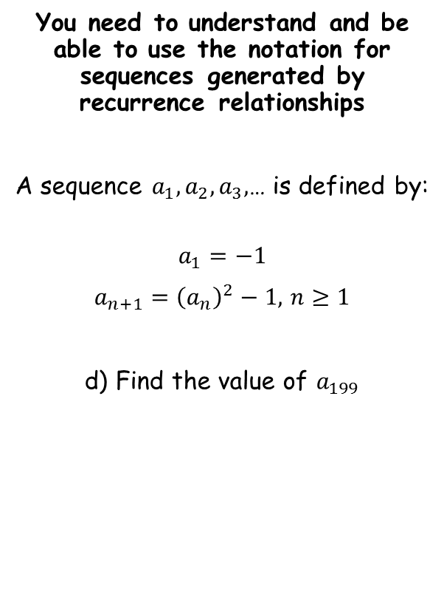



Sequences and Series
You need to understand and be able to use the notation for sequences generated by recurrence relationships
A sequence $a_{1}, a_{2}, a_{3},$… is defined by:
$$a_{1}=−1$$
$a_{n+1}={\left(a_{n}\right)}^{2}−1,$ $n≥1$
d) Find the value of $a_{199}$
$$a_{1}=−1$$
Square and then subtract 1
$$a_{2}=0$$
Square and then subtract 1
$$a_{3}=−1$$
Square and then subtract 1
$$a_{4}=0$$
Every ‘odd’ term is equal to -1
→ Therefore $a_{199}=−1$
3G

Slide 56
Teachings for
Section 3H

Slide 57

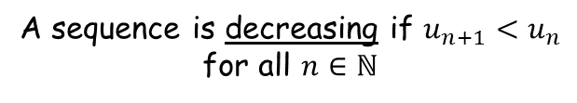

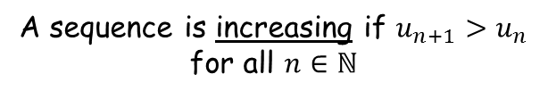


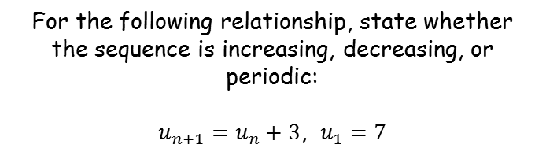

Sequences and Series
You need to be able to recognize whether a recurrence relationship generates an increasing, decreasing, or periodic sequence
For the following relationship, state whether the sequence is increasing, decreasing, or periodic:
$u_{n+1}=u_{n}+3$, $u_{1}=7$
A sequence is increasing if $u_{n+1}>u_{n}$ for all $n∈ℕ$
Generate the first few terms…
$$u_{1}=7$$
$$u_{2}=10$$
$$u_{3}=13$$
$$u_{4}=16$$
A sequence is decreasing if $u_{n+1}<u_{n}$ for all $n∈ℕ$
The sequence will be increasing since $u_{n+1}>u_{n}$ for all $n∈ℕ$
A sequence is periodic if the terms repeat in a cycle
→ The number of terms in the repeating pattern is known as the period/order of the sequence
3H

Slide 58




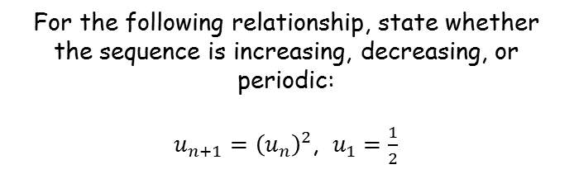

Sequences and Series
You need to be able to recognize whether a recurrence relationship generates an increasing, decreasing, or periodic sequence
For the following relationship, state whether the sequence is increasing, decreasing, or periodic:
$u_{n+1}={\left(u_{n}\right)}^{2}$, $u_{1}=\frac{1}{2}$
A sequence is increasing if $u_{n+1}>u_{n}$ for all $n∈ℕ$
Generate the first few terms…
$$u_{1}=\frac{1}{2}$$
$$u_{2}=\frac{1}{4}$$
$$u_{3}=\frac{1}{16}$$
$$u_{4}=\frac{1}{256}$$
A sequence is decreasing if $u_{n+1}<u_{n}$ for all $n∈ℕ$
The sequence will be decreasing since $u_{n+1}<u_{n}$ for all $n∈ℕ$
A sequence is periodic if the terms repeat in a cycle
→ The number of terms in the repeating pattern is known as the period/order of the sequence
3H

Slide 59









Sequences and Series
You need to be able to recognize whether a recurrence relationship generates an increasing, decreasing, or periodic sequence
For the following relationship, state whether the sequence is increasing, decreasing, or periodic:
$$u_{n}=sin⁡(90n)$$
A sequence is increasing if $u_{n+1}>u_{n}$ for all $n∈ℕ$
Generate the first few terms…
$$u_{1}=1$$
$$u_{2}=0$$
$$u_{3}=−1$$
$$u_{4}=0$$
$$u_{5}=1$$
$$u_{6}=0$$
$$u_{7}=−1$$
$$u_{8}=0$$
A sequence is decreasing if $u_{n+1}<u_{n}$ for all $n∈ℕ$
The sequence will be periodic with an order of 4
A sequence is periodic if the terms repeat in a cycle
→ The number of terms in the repeating pattern is known as the period/order of the sequence
3H

Slide 60
Sequences and Series
You need to be able to recognize whether a recurrence relationship generates an increasing, decreasing, or periodic sequence
A sequence is increasing if $u_{n+1}>u_{n}$ for all $n∈ℕ$
A sequence is decreasing if $u_{n+1}<u_{n}$ for all $n∈ℕ$
→ Note that some sequences will not be any of these!
A sequence is periodic if the terms repeat in a cycle
→ The number of terms in the repeating pattern is known as the period/order of the sequence
3H

Slide 61
Teachings for
Section 3I

Slide 62













Sequences and Series
$$u_{n}=ar^{n−1}$$
$$S_{∞}=\frac{a}{1−r}$$
$$S_{n}=\frac{n}{2}\left(2a+\left(n−1\right)d\right)$$
$$u_{n}=a+(n−1)d$$
$$S_{n}=\frac{a\left(1−r^{n}\right)}{(1−r)}$$
$$S_{n}=\frac{n}{2}\left(a+l\right)$$
You need to be able to use your knowledge of sequences to model situations given in context
Bruce starts a new company. He estimates that in Year 1 his profits will be £20000, and he predicts that his profits will increase by £5000 per year from that point on. He then models that once his annual profits reach £100000, they will then remain constant.
Calculate the profit for Bruce’s business in the first 20 years
$$a=20000$$
$$d=5000$$
$$u_{n}=100000$$
$$n= ?$$
$$u_{n}=a+(n−1)d$$
Sub in values
$$100000=20000+\left(n−1\right)5000$$
Subtract 20000
$$80000=\left(n−1\right)5000$$
Divide by 5000
$$16=n−1$$
Add 1
$$17=n$$
So the first 17 terms follow the pattern stated in the question…
→ The total money earned will therefore be the sum of these first 17 terms, plus £300000 extra for Years 18, 19 and 20.
We will need to find out when his profits reach £100000 per year, since at this point the pattern changes…
→ It starts as an arithmetic series…
3I

Slide 63





Sequences and Series
$$u_{n}=ar^{n−1}$$
$$S_{∞}=\frac{a}{1−r}$$
$$S_{n}=\frac{n}{2}\left(2a+\left(n−1\right)d\right)$$
$$u_{n}=a+(n−1)d$$
$$S_{n}=\frac{a\left(1−r^{n}\right)}{(1−r)}$$
$$S_{n}=\frac{n}{2}\left(a+l\right)$$
You need to be able to use your knowledge of sequences to model situations given in context
Bruce starts a new company. He estimates that in Year 1 his profits will be £20000, and he predicts that his profits will increase by £5000 per year from that point on. He then models that once his annual profits reach £100000, they will then remain constant.
Calculate the profit for Bruce’s business in the first 20 years
$$a=20000$$
$$d=5000$$
$$u_{n}=100000$$
$$n=17$$
$$S_{n}=\frac{n}{2}\left(2a+\left(n−1\right)d\right)$$
Sub in values
$$S_{n}=\frac{17}{2}\left(2(20000)+\left(17−1\right)5000\right)$$
Calculate
$$S_{n}=1020000$$
Add on the extra £300000
$$S_{n}=1320000$$
First 17 terms, then add £300000
3I

Slide 64

Sequences and Series
$$u_{n}=ar^{n−1}$$
$$S_{∞}=\frac{a}{1−r}$$
$$S_{n}=\frac{n}{2}\left(2a+\left(n−1\right)d\right)$$
$$u_{n}=a+(n−1)d$$
$$S_{n}=\frac{a\left(1−r^{n}\right)}{(1−r)}$$
$$S_{n}=\frac{n}{2}\left(a+l\right)$$
You need to be able to use your knowledge of sequences to model situations given in context
Bruce starts a new company. He estimates that in Year 1 his profits will be £20000, and he predicts that his profits will increase by £5000 per year from that point on. He then models that once his annual profits reach £100000, they will then remain constant.
Calculate the profit for Bruce’s business in the first 20 years
State a reason why this model might not be suitable
A possible reason would be that it is unlikely that Bruce’s profits will increase by the exact same amount every year
$$S_{n}=1320000$$
3I

Slide 65







Sequences and Series
$$u_{n}=ar^{n−1}$$
$$S_{∞}=\frac{a}{1−r}$$
$$S_{n}=\frac{n}{2}\left(2a+\left(n−1\right)d\right)$$
$$u_{n}=a+(n−1)d$$
$$S_{n}=\frac{a\left(1−r^{n}\right)}{(1−r)}$$
$$S_{n}=\frac{n}{2}\left(a+l\right)$$
You need to be able to use your knowledge of sequences to model situations given in context
Bruce starts a new company. He estimates that in Year 1 his profits will be £20000, and he predicts that his profits will increase by £5000 per year from that point on. He then models that once his annual profits reach £100000, they will then remain constant.
Bruce’s financial advisor says that it is more likely that his profits would increase by 5% per year. Using this model instead, calculate the profits that Bruce will make in the first 20 years.
$$a=20000$$
$$r=1.05$$
$$S_{n}= ?$$
$$n=20$$
$$S_{n}=\frac{a\left(1−r^{n}\right)}{(1−r)}$$
Calculate
$$S_{n}=\frac{20000\left(1−{1.05}^{20}\right)}{(1−1.05)}$$
Calculate
$$S_{n}=£661319.08$$
Increasing by 5% is calculated by multiplying by 1.05
→ 1.05 is therefore the common ratio
3I

Slide 66







Sequences and Series
$$u_{n}=ar^{n−1}$$
$$S_{∞}=\frac{a}{1−r}$$
$$S_{n}=\frac{n}{2}\left(2a+\left(n−1\right)d\right)$$
$$u_{n}=a+(n−1)d$$
$$S_{n}=\frac{a\left(1−r^{n}\right)}{(1−r)}$$
$$S_{n}=\frac{n}{2}\left(a+l\right)$$
You need to be able to use your knowledge of sequences to model situations given in context
A piece of A4 paper is folded in half repeatedly. The thickness of the sheet is 0.5mm.
Work out the thickness after 4 folds
Work out the thickness after 20 folds
State one reason why this might be an unrealistic model
$$a=0.5$$
$$r=2$$
$$u_{n}= ?$$
$$n=5$$
Be careful here. If we include the start width, then after 4 folds, we will be on the 5th value in the sequence…
$$u_{n}=ar^{n−1}$$
Sub in values
$$u_{n}=0.5{(2)}^{5−1}$$
Calculate
$$u_{n}=8$$
Each fold will double the thickness of the sheet
→ The starting thickness is 0.5mm
3I

Slide 67





Sequences and Series
$$u_{n}=ar^{n−1}$$
$$S_{∞}=\frac{a}{1−r}$$
$$S_{n}=\frac{n}{2}\left(2a+\left(n−1\right)d\right)$$
$$u_{n}=a+(n−1)d$$
$$S_{n}=\frac{a\left(1−r^{n}\right)}{(1−r)}$$
$$S_{n}=\frac{n}{2}\left(a+l\right)$$
You need to be able to use your knowledge of sequences to model situations given in context
A piece of A4 paper is folded in half repeatedly. The thickness of the sheet is 0.5mm.
Work out the thickness after 4 folds
Work out the thickness after 20 folds
State one reason why this might be an unrealistic model
$$a=0.5$$
$$r=2$$
$$u_{n}= ?$$
$$n=20$$
Be careful here. If we include the start width, then after 20 folds, we will be on the 21st value in the sequence…
$$u_{n}=ar^{n−1}$$
Sub in values
$$u_{n}=0.5{(2)}^{21−1}$$
Calculate
$$8mm$$
$$u_{n}=524288$$
$$=524.288m$$
Each fold will double the thickness of the sheet
→ The starting thickness is 0.5mm
3I

Slide 68

Sequences and Series
$$u_{n}=ar^{n−1}$$
$$S_{∞}=\frac{a}{1−r}$$
$$S_{n}=\frac{n}{2}\left(2a+\left(n−1\right)d\right)$$
$$u_{n}=a+(n−1)d$$
$$S_{n}=\frac{a\left(1−r^{n}\right)}{(1−r)}$$
$$S_{n}=\frac{n}{2}\left(a+l\right)$$
You need to be able to use your knowledge of sequences to model situations given in context
A piece of A4 paper is folded in half repeatedly. The thickness of the sheet is 0.5mm.
Work out the thickness after 4 folds
Work out the thickness after 20 folds
State one reason why this might be an unrealistic model
PAPER FOLDING THEOREM
$$8mm$$
$$524.288m$$
It is not possible to fold the piece of paper beyond a certain amount, so the model is unrealistic
3I

